Slide 1
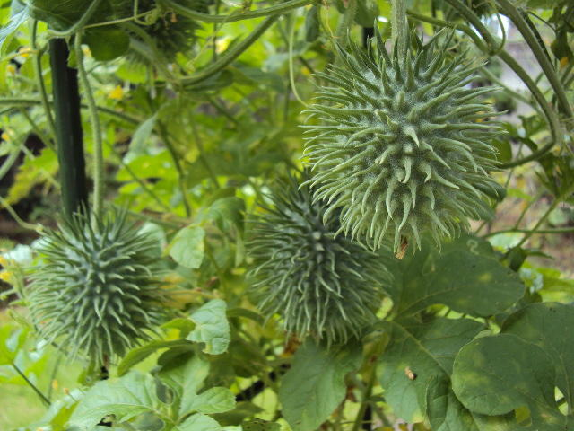
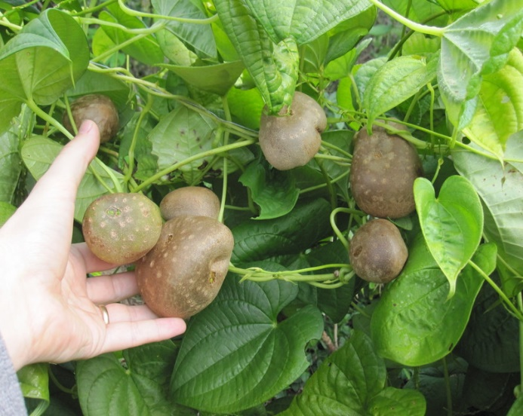
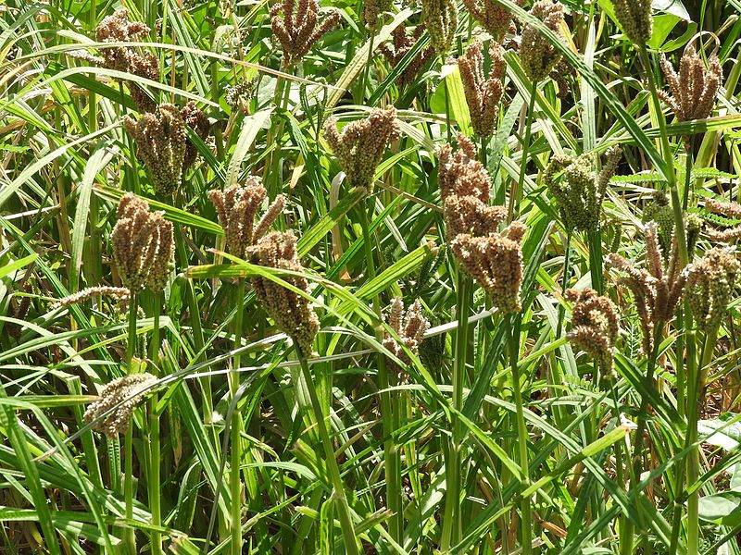
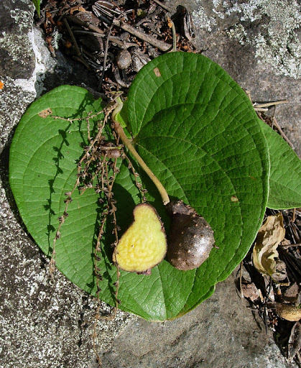
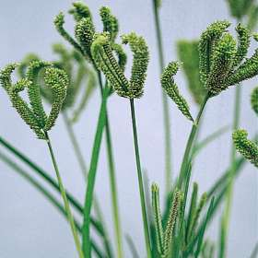
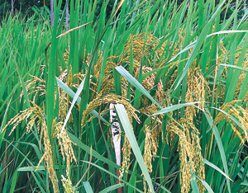
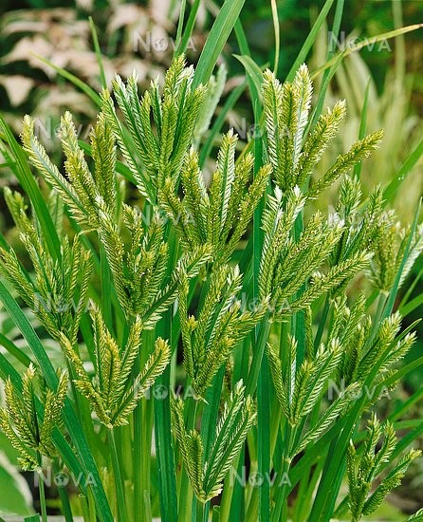
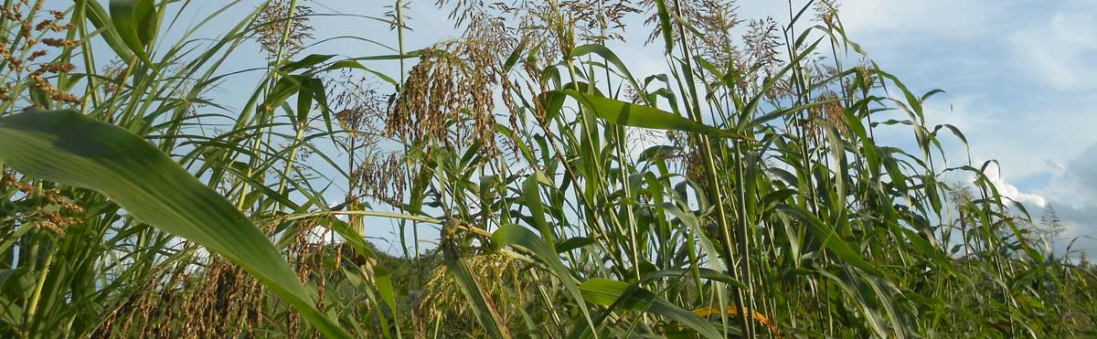
CLIMATE CHANGE
Mitigation & Adaptation (SA400)
Kapasa Makasa University
Department of Agriculture & Aquatic Sciences (AAS)
M. Tembo

Slide 2
CONCEPTUAL DEFINITIONS
Weather: the day to day changes in the atmosphere.
The atmospheric conditions of a particular place at a particular time.
Weather is local and temporary.
Rain, snow, wind, sunshine, cyclones, hurricanes, tornadoes - these are all weather events

Slide 3
CONCEPTUAL DEFINITIONS….
2. Climate: the long term, 30-year average of the weather.
Climate is driven by the sun’s energy and influenced by many factors (ocean currents, glaciers, polar ice caps, the earth’s land surface, living organisms in the oceans and on land, etc.).

Slide 4
CONCEPTUAL DEFINITIONS….
3. Climate Change: is defined as the periodic modification of Earth’s climate as a result of changes in the atmosphere as well as interactions between the atmosphere and various other geologic, chemical, biological, and geographic factors within the Earth system.

Slide 5
Therefore,
A few years of unusually wet or dry weather do not necessarily reflect trends in climatic change
However, long-term weather records show a definite trend of global atmospheric changes.

Slide 6
Climate Change (Cont’d)….
Any process that causes adjustments to a climate system could be described as creating “climate change”.
However, the current period of warming is occurring more rapidly than many past events.
The rapid human-induced warming has serious implications for the stability of the planet’s climate
Humans are principally affecting the climate through the release of heat-trapping greenhouse gases into the air.

Slide 7
CLIMATE CHANGE IS HAPPENING
Levels of CO₂ have risen by over 40% since the industrial revolution.
Concentration of Green House Gases (GHG) such as Methane (CH₄) and Nitrous oxide have continued to rise.
Generally, climate change will increase the frequency and intensity of both flooding and droughts (Houghton, 2005).
Lower rainfall is expected notably in southern Africa, north Africa, central America, and central Asia
Rise in global average temperatures (projections of b/n 1.4-5.8 degrees centigrade).
Increases in tropical cyclones since the 1970s (More recently, Tropical Cyclone Gezani on 10th Feb, 26…Madagascar).

Slide 8
CLIMATE CHANGE IS HAPPENING….
There are substantial changes in the flow regimes of rivers, influencing water availability and quality.
Some areas are getting wetter and others drier (IPCC 2001e)
With frequent floods, soil erosion is being accelerated
Increased evaporation is causing the flow in rivers and streams to decline.
Higher water temperatures are reducing water quality, e.g. promoting algal blooms.
Sea levels are rising due to the world-wide retreat of glaciers and accelerated melting of polar ice sheets

Slide 9
SO, WHAT?
Climate change is a reality, and the debate about whether it is real or not is over. Inaction can no longer be justified on the basis of uncertainty.
Debate must now focus on what action is needed to cut GHG emissions and to enable people cope with the impacts of climate change.

Slide 10
Gas Composition in a Natural Atmosphere
Naturally, the atmosphere contains the following gases arranged in order of proportional composition:
Nitrogen – 78%
Oxygen – 21%
Argon – 1%
Carbon dioxide – (0.03%)
Other gases – less than 1%

Slide 11
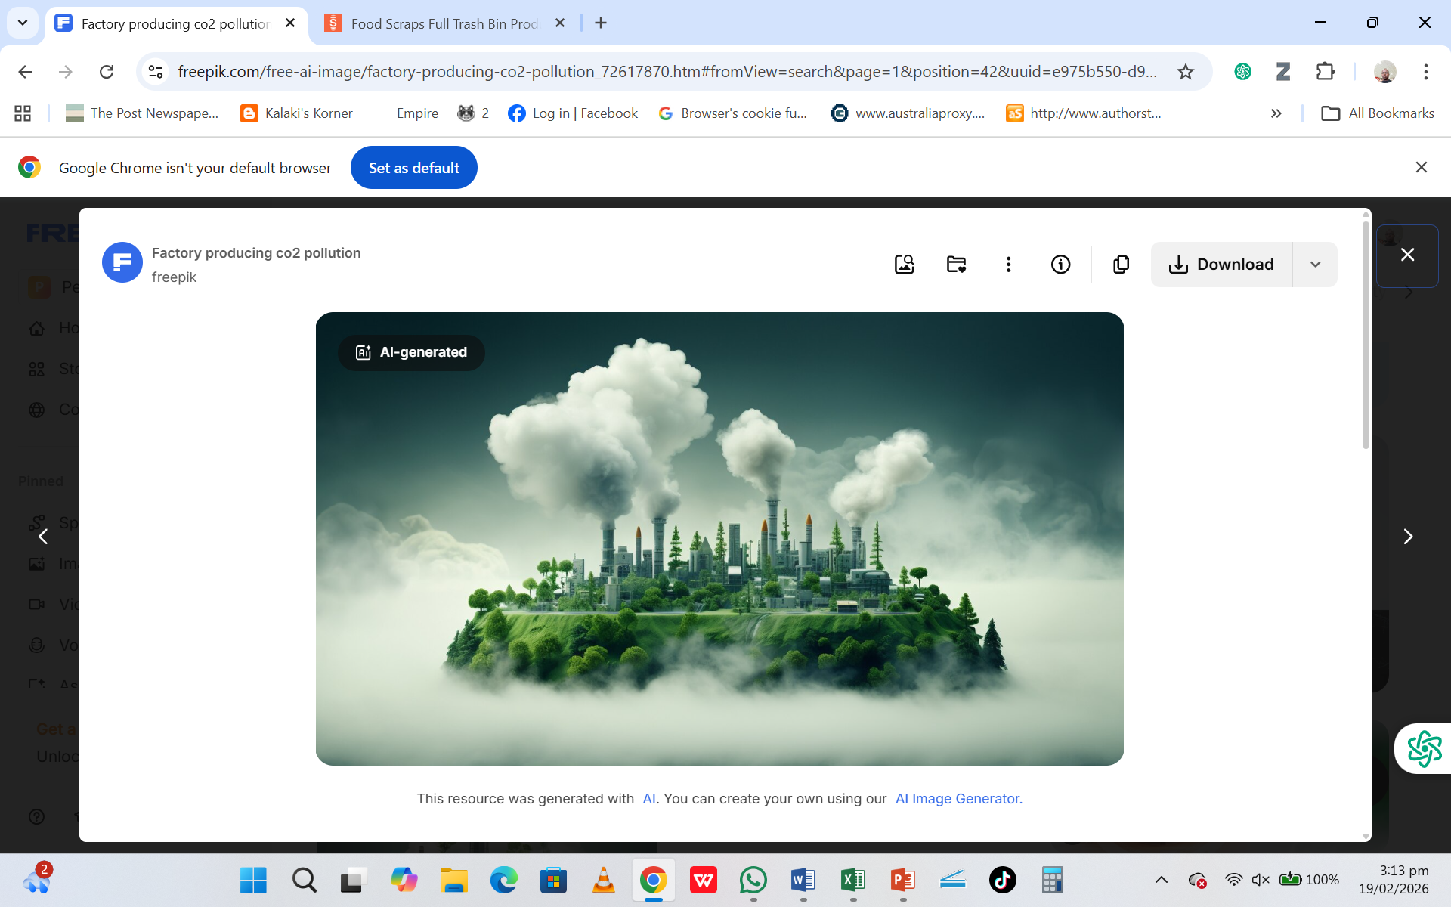
The emission of Green house gases (GHGs) has distorted the natural composition of gases!

Slide 12
GREEN HOUSE GASES (GHG)
What are these green house gases???
GHG are atmospheric gases that can trap heat. They get their name from horticultural greenhouses because they function in much the same way as horticultural green houses.
A greenhouse is made up of glass roof and walls that let in sunlight (insolation). That insolation creates warmth (infrared).
The big trick of a greenhouse is that it doesn’t let that warmth escape. That’s exactly how GHG behave. They let insolation pass through the atmosphere, but they prevent the heat (infrared) that the insolation brings from leaving the atmosphere.

Slide 13
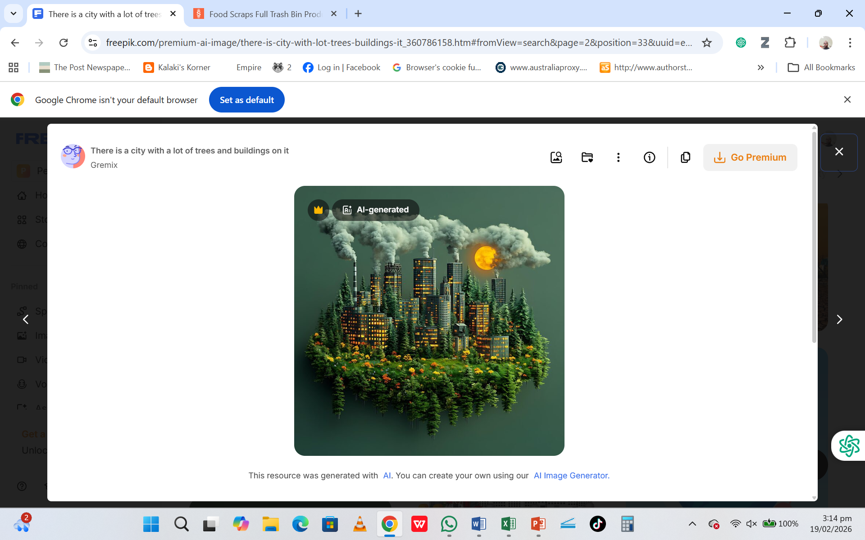
Greenhouse Gases (GHG)…
Until recently carbon dioxide was considered to be the main greenhouse gas responsible for global warming.
It is now becoming clear that other gases particularly Methane, Nitrous oxide (laughing gas), Ozone and Cholorofluorocarbons (CFCs) absorb a range of ultraviolet (UV) radiation where Carbon dioxide and water vapour are ineffective.

Slide 14
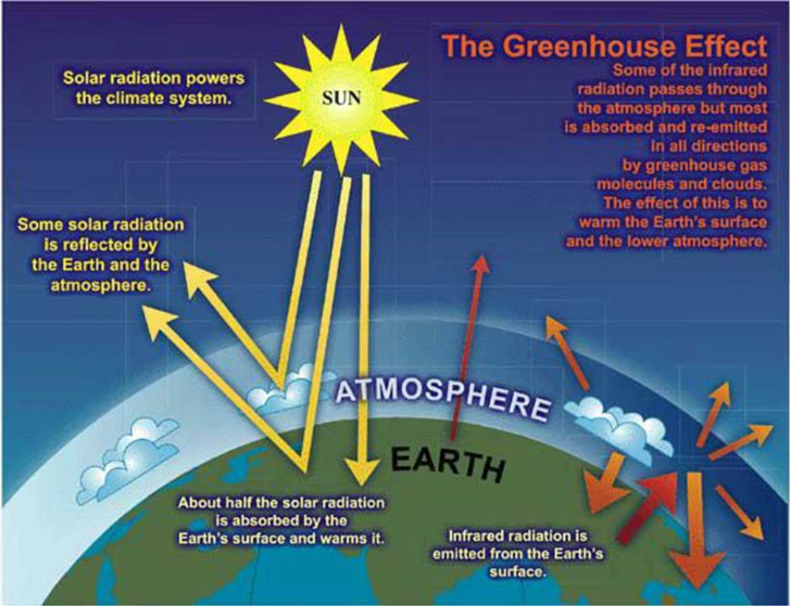

Slide 15
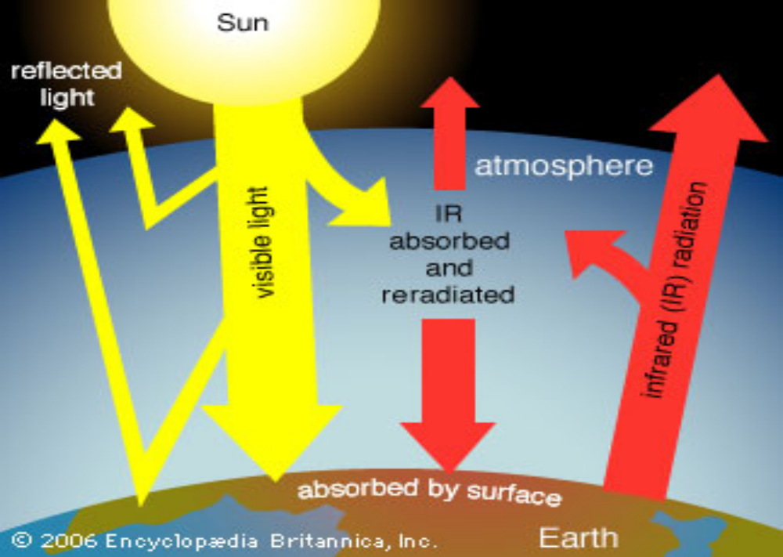

Slide 16
As can be seen from diagram above:
Some incoming sunlight (UV) is reflected by the Earth's atmosphere and surface, but most is absorbed by the surface, which is warmed.
The captured heat is what makes the earth livable!
Infrared (IR) radiation is then emitted from the surface.
Without it (IR), the average temperature of the earth’s surface would be well below freezing point, some 33ºC lower than its present 15ºC.

Slide 17
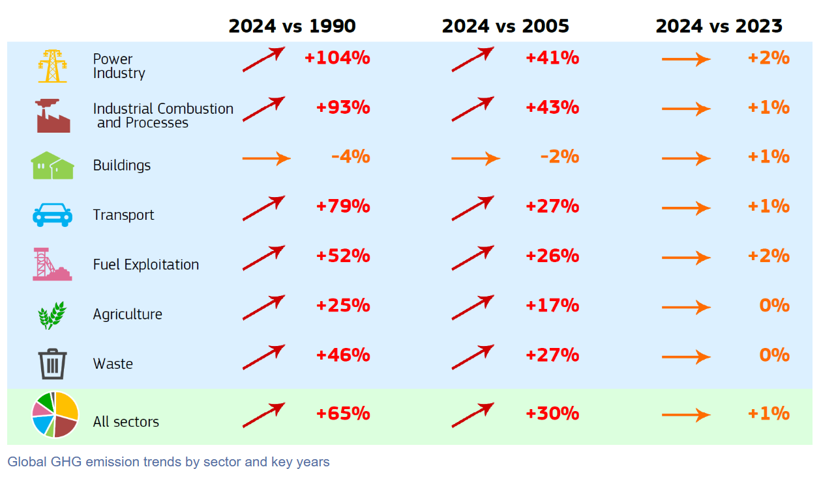

Slide 18
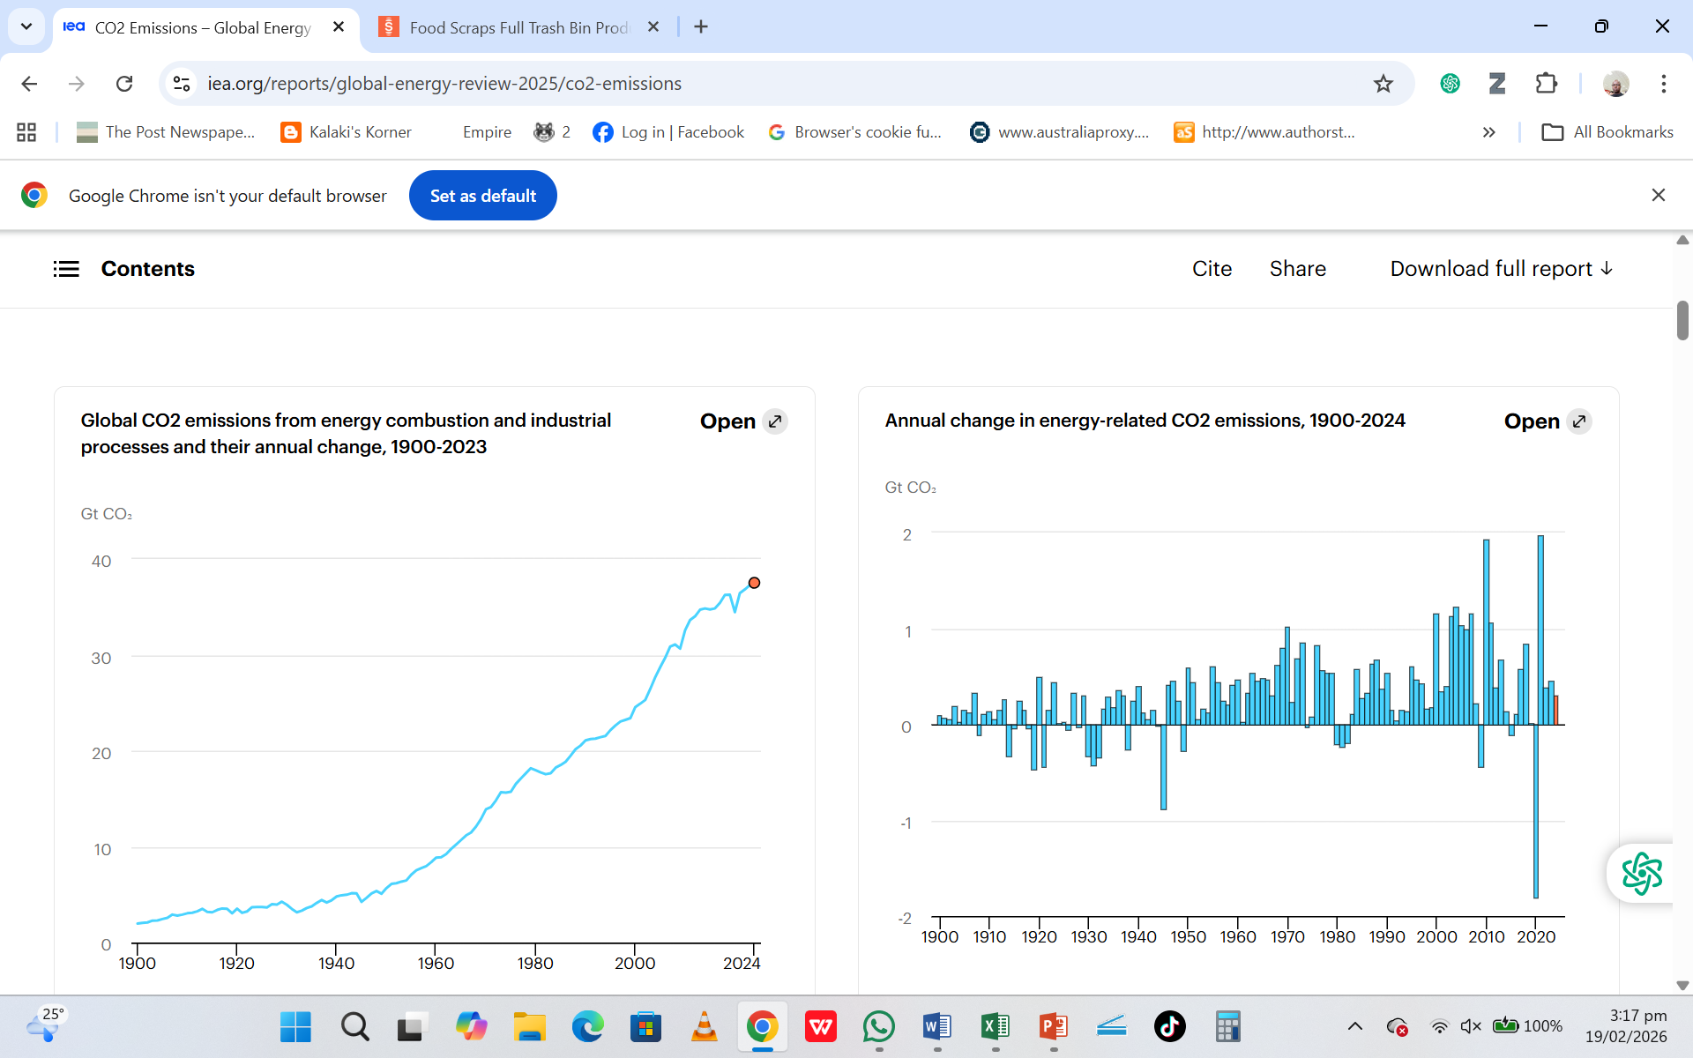

Slide 19
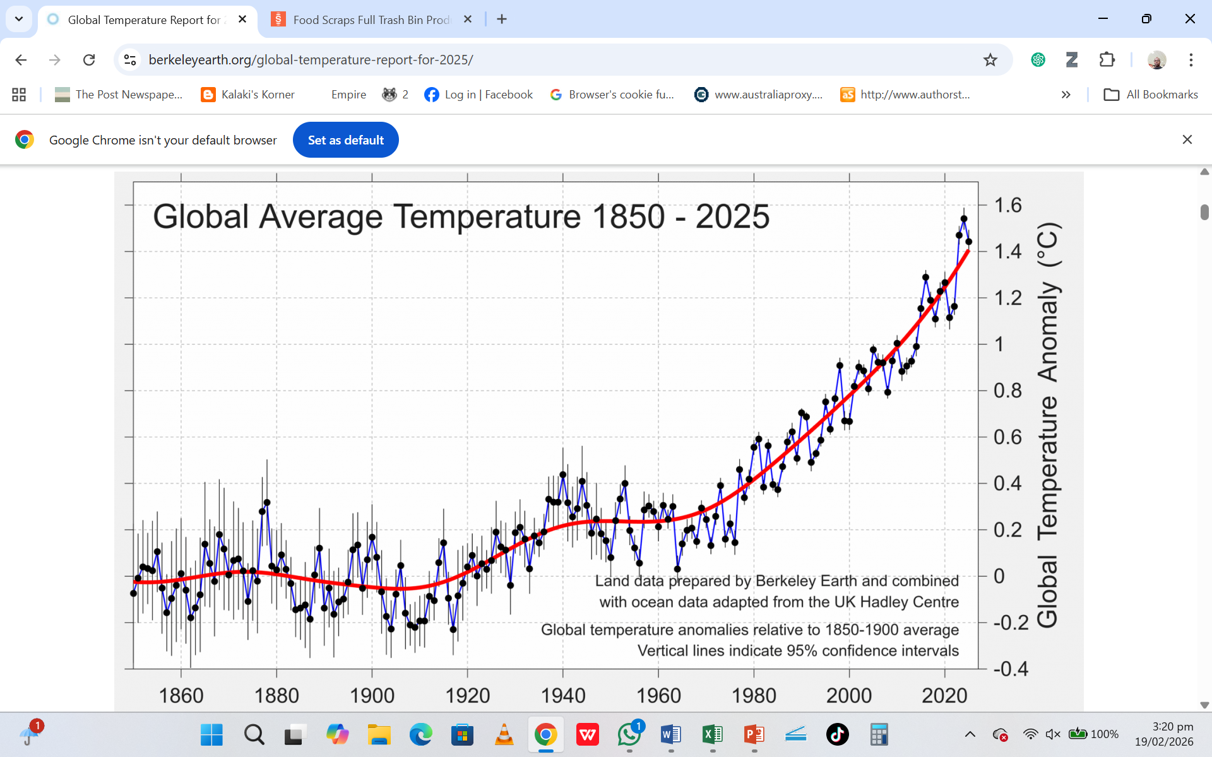

Slide 20
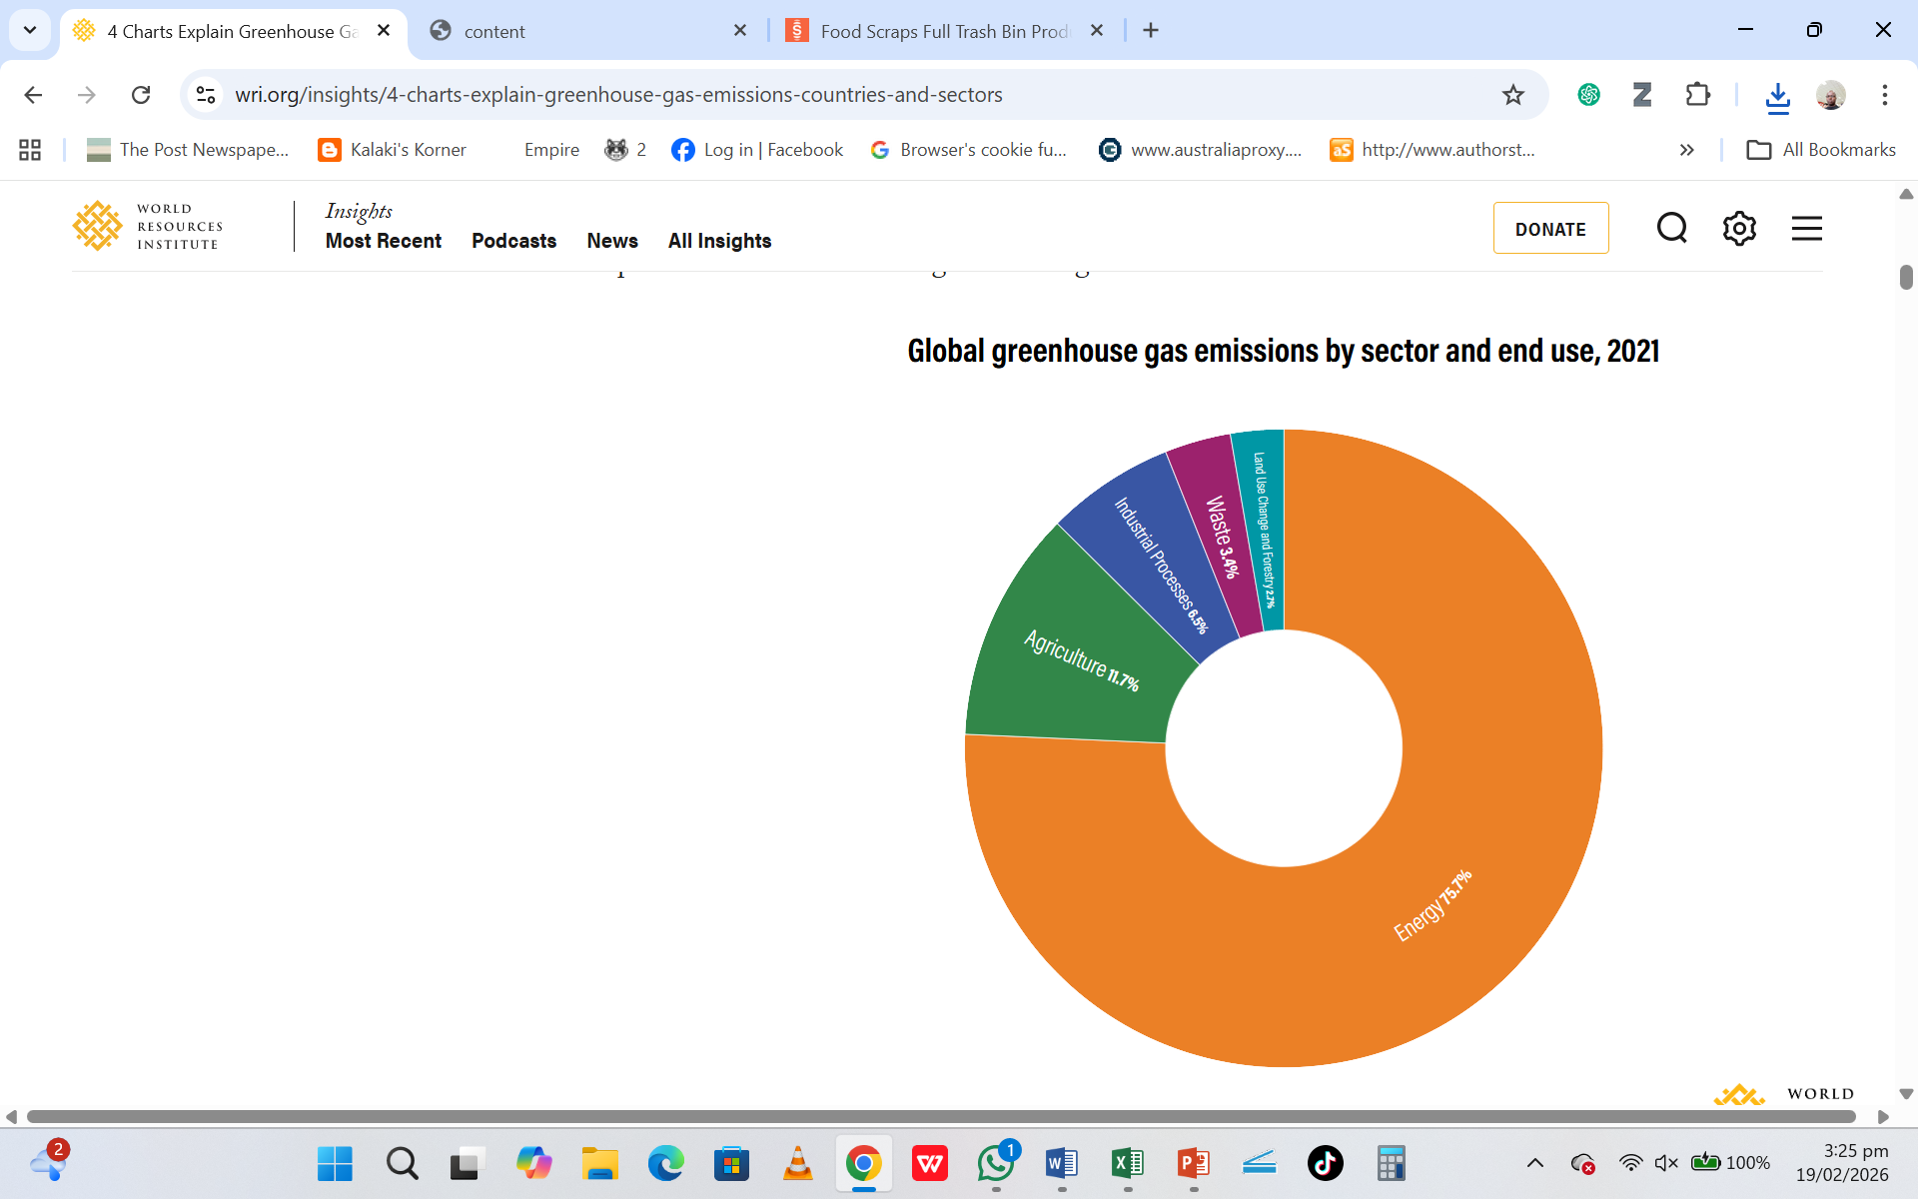

Slide 21
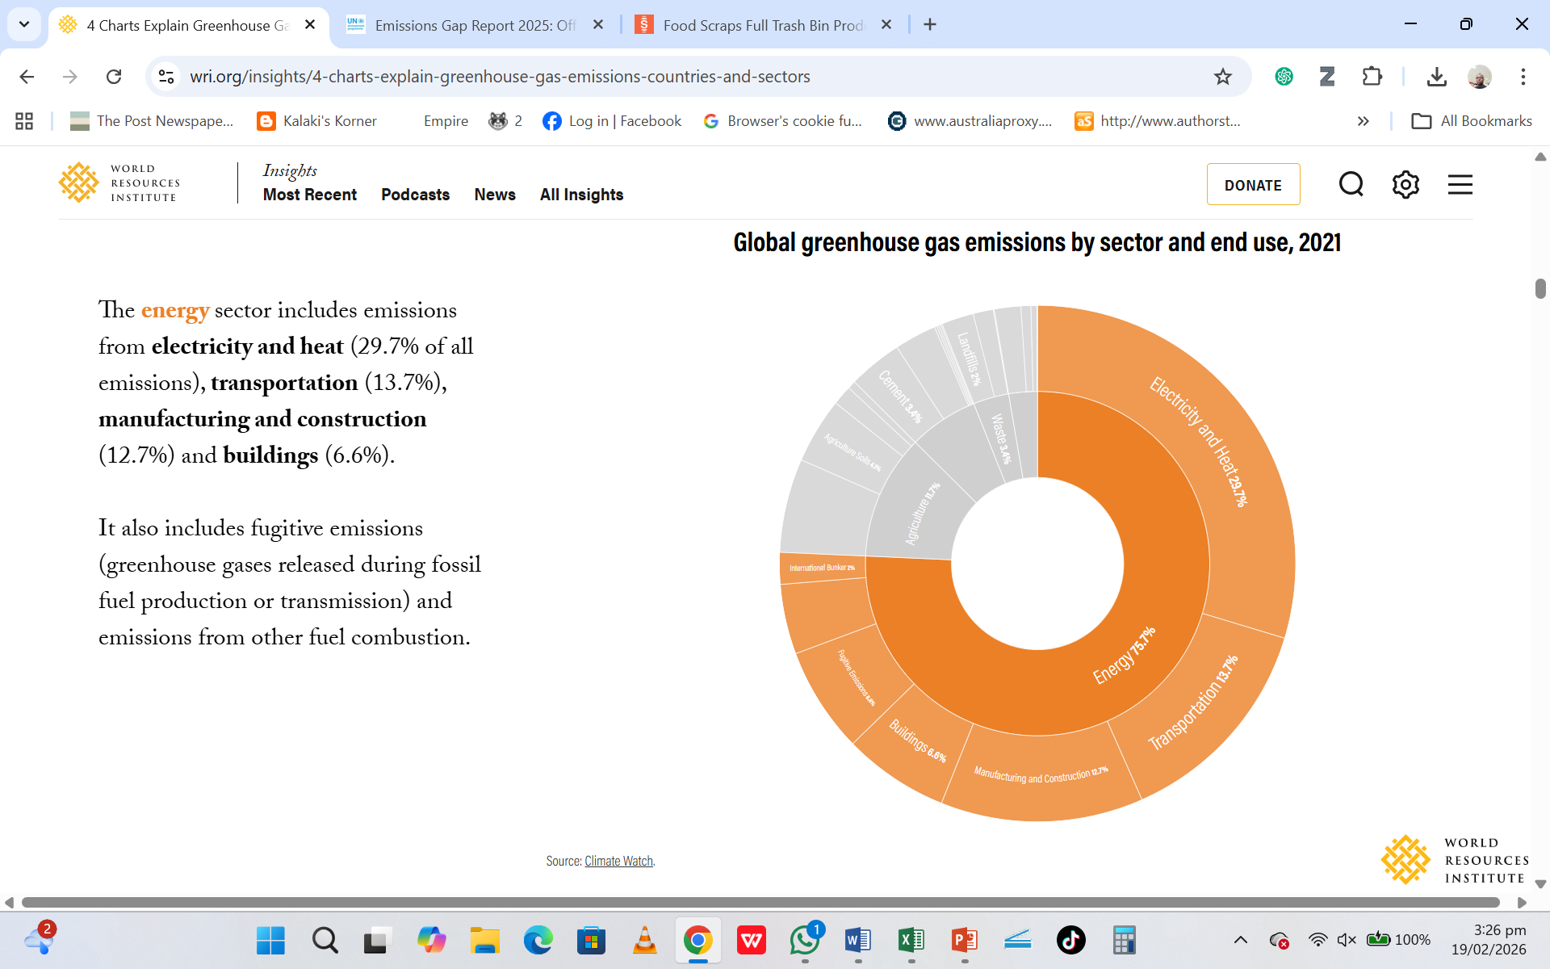

Slide 22
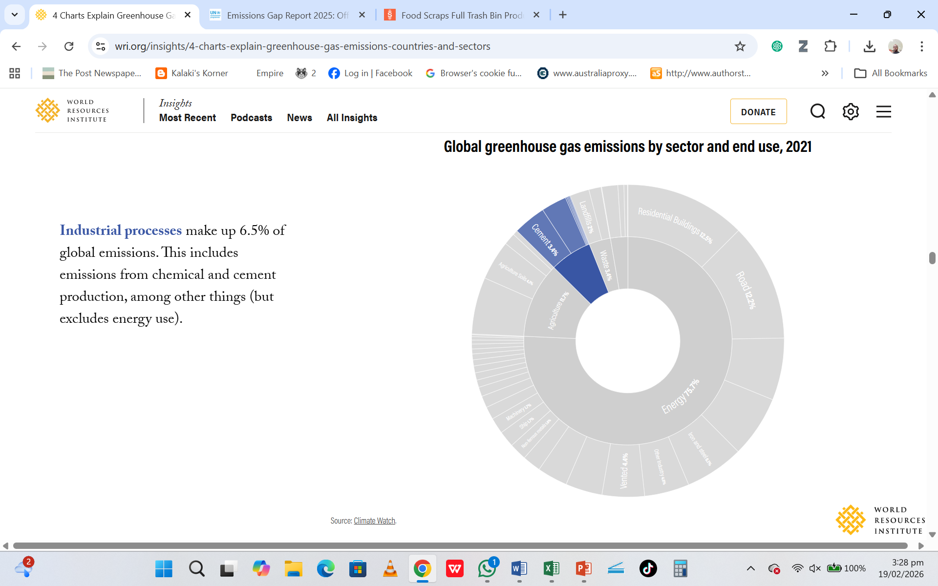

Slide 23
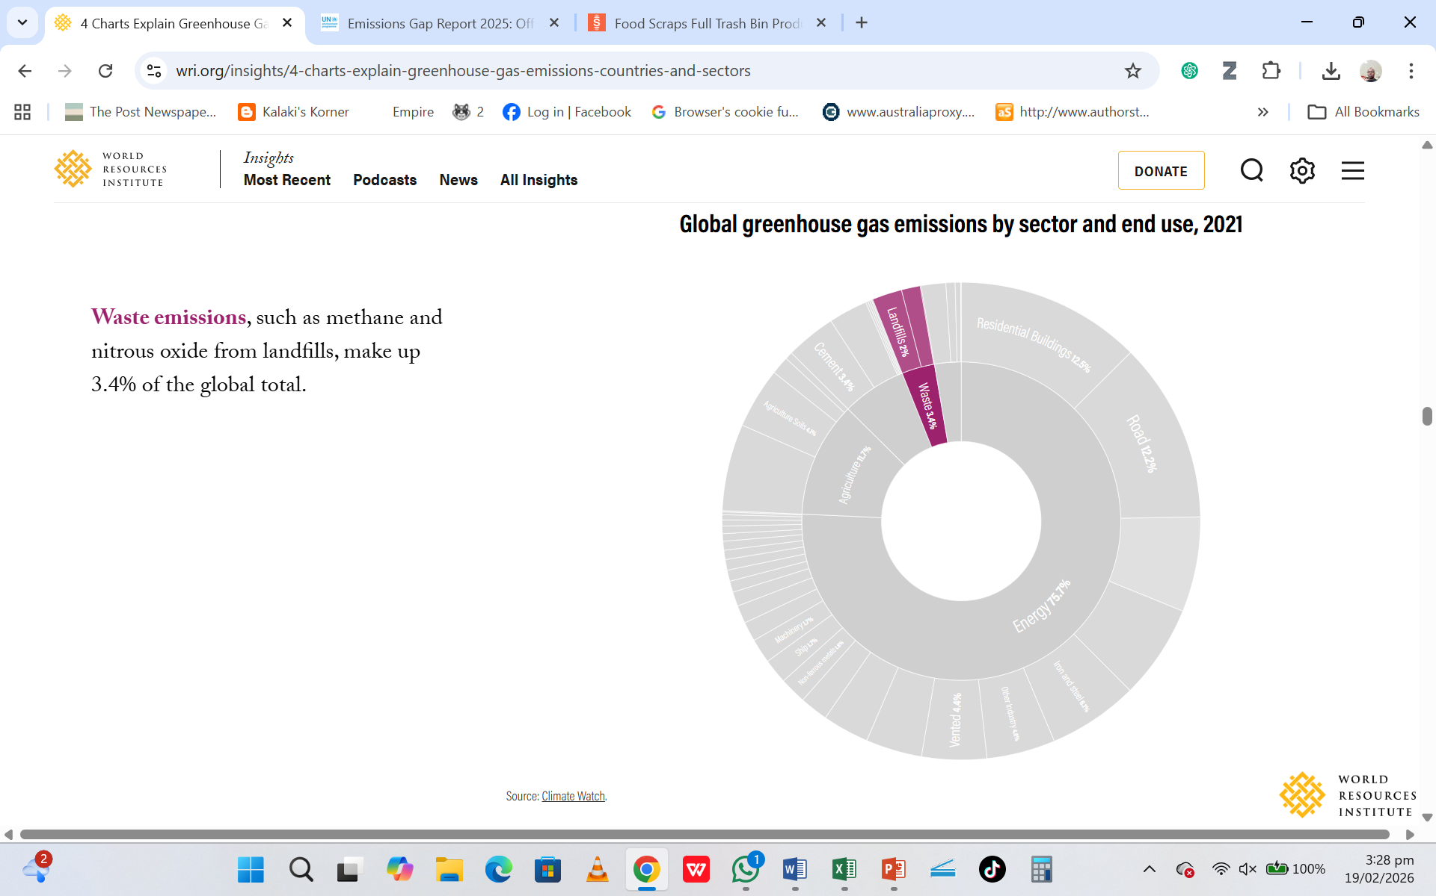

Slide 24
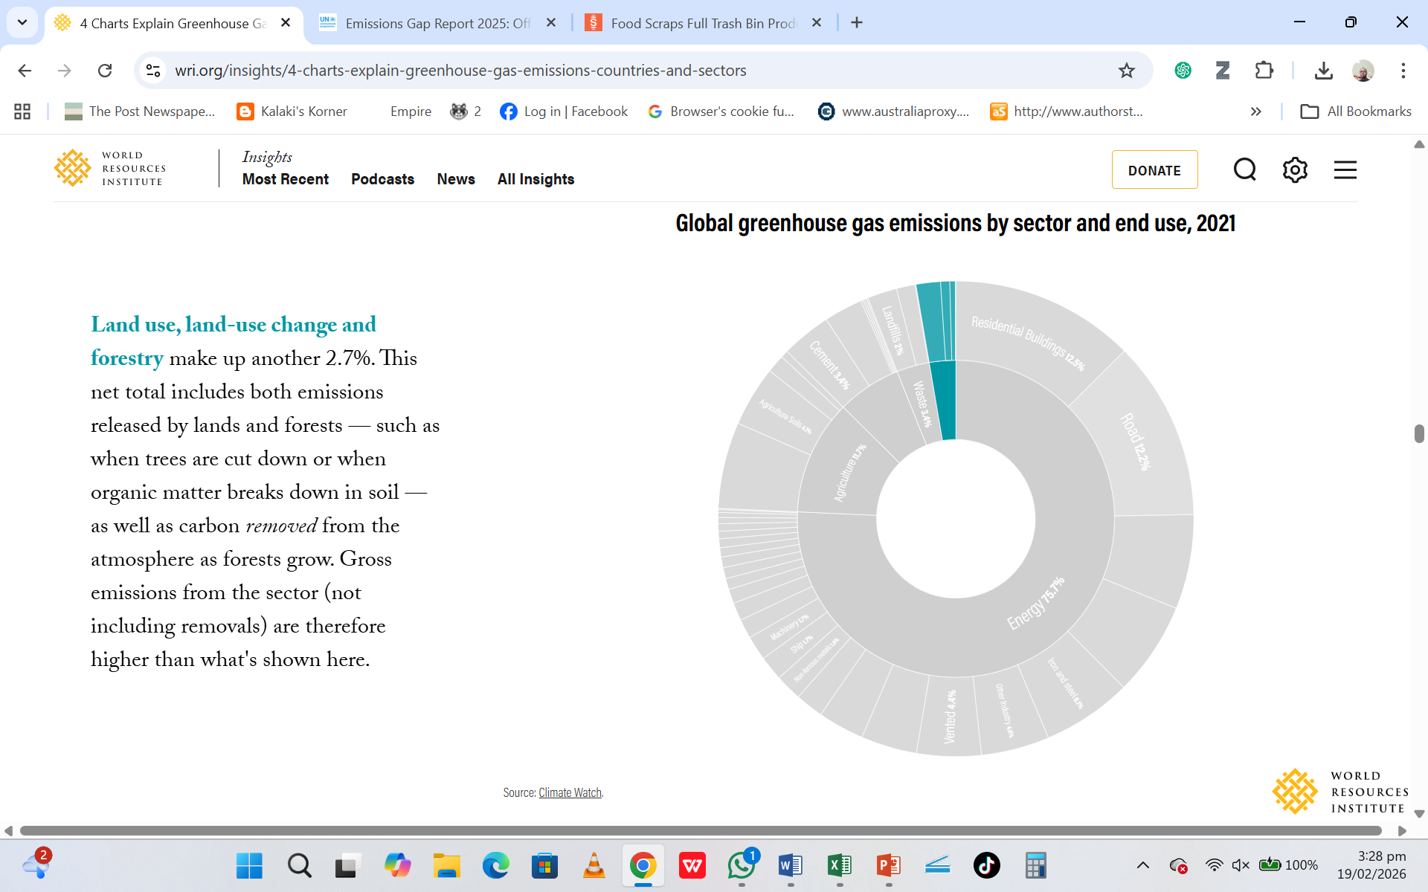

Slide 25
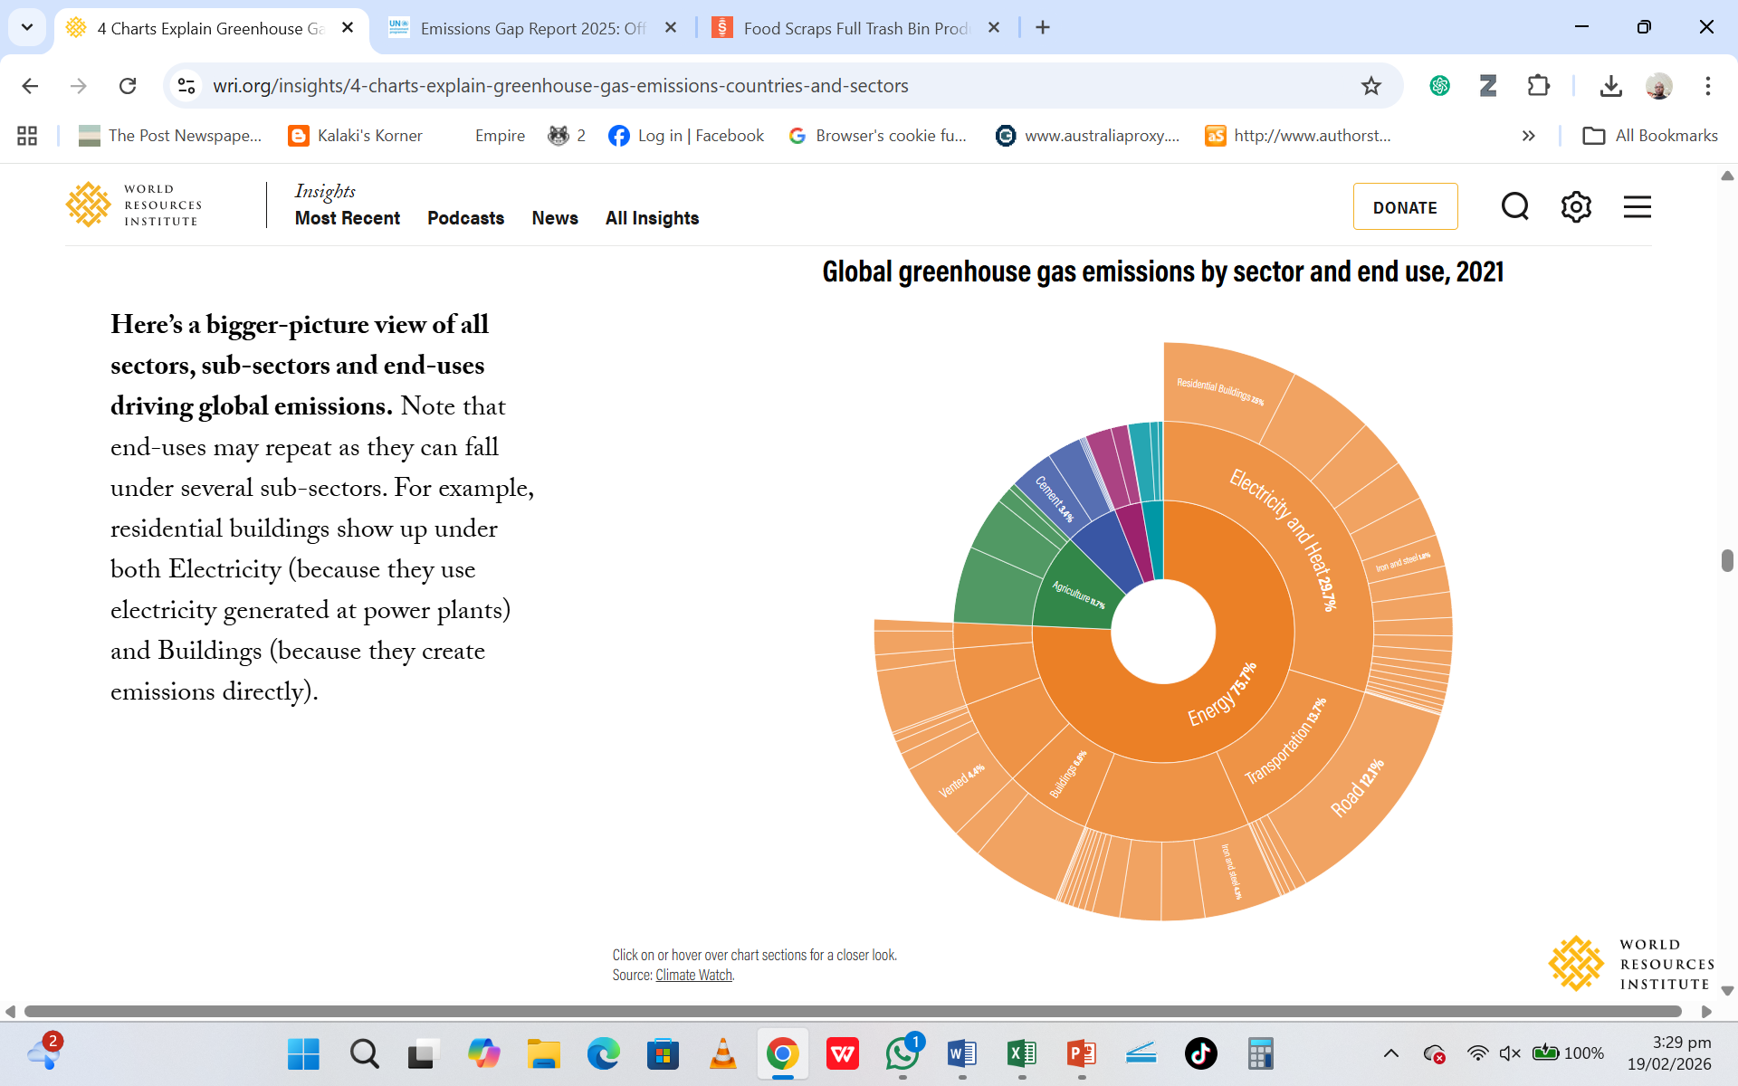

Slide 26
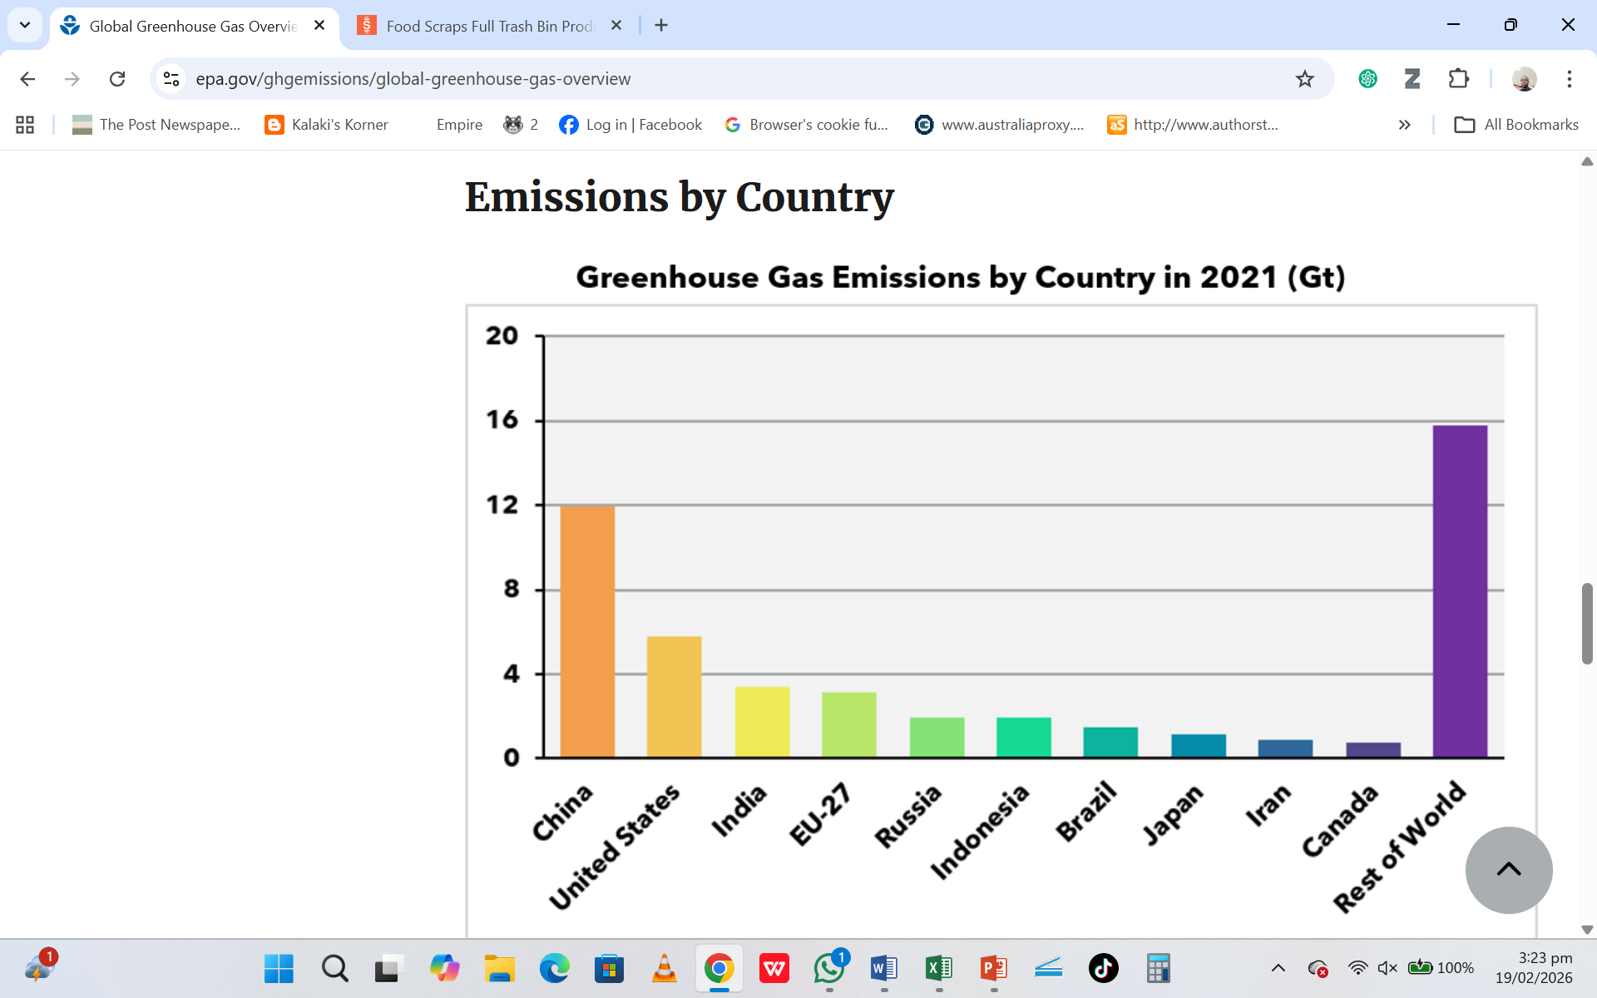

Slide 27
Sources of GHGs
The CO₂ and other non- CO₂ GHGs, largely Methane (CH4) and Nitrous oxide (N₂O), are constantly released to the atmosphere by:
    plant and animal respiration
    decomposition of dead plant biomass and soil organic matter, and
    Combustion of fossil fuels

Slide 28
Water Vapour (2H₂O) is water in gaseous form which forms clouds and falls back to earth as rain. [It’s a GHG with a very short residence period of 1 week]
CO₂ is released when burning fossil fuels, coal and oil. It’s the most important contributor to human-induced global warming. It also has the longest atmospheric residence period of about 1000 years.

Slide 29
Nitrous Oxide (N₂O)
Once used as a light anaesthetic, N₂O causes people to laugh and so is known as a laughing gas.
Its main source in the atmosphere is in tiny organisms called microbes which live in the soil and water.
It’s largest source is agric (artificial nitrogen-based ferts & manure), biomass burning, waste mgt, prod of nitric acid, etc.

Slide 30
Nitrous Oxide (N₂O)…
Tropical forest soils produce almost half the annual nitrous oxides.
Deforestation and cultivation increases nitrous oxide production because the soils are exposed to more sunlight and air.
nitrous oxides are also a product of fossil fuel burning, particularly aeroplanes.
N₂O has a residence period of ~114-121 years

Slide 31
Ozone (O₃)
O₃ is a form of oxygen which occurs naturally, and is also produced when vehicle emissions interact with sunlight.
The earth could be in jeopardy without the O₃ layer, which has a key role in regulating global temperatures because it determines the amount of UV radiation reaching the earth’s surface.
The UV radiation it screens out is highly damaging to animal and plant life.

Slide 32
Ozone (O₃)….
Though it shields the earth from the damaging effects of UV radiation when high in the atmosphere, O₃ is a dangerous pollutant when in the lower atmosphere, damaging human lungs and plant growth and contributes to the green house effect. [O₃ is located in the stratosphere about 15 – 50 km above the surface of the earth].
In the lower atmosphere, O₃ acts as a GHG, with a residence period of 1-4 weeks
O₃ can be formed by combustion of fuels, solvents, etc.

Slide 33
Methane (CH₄)
CH_{4,} with an atmospheric life time of 12 years, is a gas released from wetlands (when organic material decays in swamps), from paddy rice growing, using natural gas and mining coal. Also called ‘rotten egg’, CH₄ is equally produced naturally by ruminants (animals which chew the cud, mainly cattle), termites (the digestive system of termites emits CH₄), etc.
The concentration of CH₄ in the atmosphere is more than double what it was 300 years ago.
It is increasing at annual rate of almost 1% adding an additional 400 – 600 million tonnes to the atmosphere each year.

Slide 34
Methane (CH₄)
CH₄ has a more concentrated effect than CO₂. A molecule of CH₄ traps 20 – 30 times more heat than a molecule of CO₂.
Studies show that rice paddies produce about 25% of all methane released to the atmosphere.

Slide 35
Chlorofluorocarbons (CFCs)
CFCs are a major threat to the ozone layer.
CFCs are synthetic, anthropogenic chemicals with no natural sources. These are manufactured gases first introduced in the US during the 1930s.
Major sources - coolants in refrigerators and air conditioners, propellants in aerosol sprays, and solvents for cleaning electronic components.
Two of them are in common use today: CFC-11 (used as a propellant in spray cans among other things) and CFC-12 (used in air conditioning and in refrigeration).

Slide 36
Chlorofluorocarbons (CFCs)…
Both CFC-11 and CFC-12 are highly persistent, remaining intact in the atmosphere for as long as 130 years. [Some CFCs have a residence period of ~500 years].
However, they are slowly both being phased out from use.
One CFC molecule can destroy 100,000 molecules of Ozone.

Slide 37
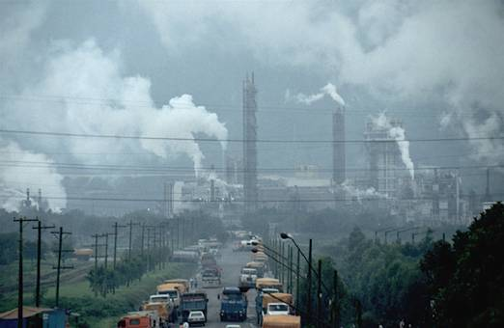

Slide 38
For almost all of human history this is the era that has had noticeable impact on the planet’s atmosphere.
In the 18th century the first steam engines and large factories appeared. Large amounts of coal were burned and large areas of forest cleared.
European countries began to colonize the world, expanding their markets for manufactured goods and taking raw materials from the south.

Slide 39
With industrial revolution came the first global pollution problems.
Since the mid 1700s the carbon dioxide concentration of the atmosphere has increased to its highest level in the past 150 years.
The decades have been recorded to be the hottest in living memory.

Slide 40
The year 1988 was the warmest, 1989 the second warmest.
The years 1980, 1981, and 1986 were all warmer than any others in the last century.
A new record was 2015 which was recorded the warmest of all the above.
In the next 30 - 60 years scientists predict, the average temperature of the earth will continue to rise by between 1- 4 degrees Celsius.

Slide 41
No. | Period | Remarks
1 | 1850 - 1900 | Deforestation, mainly in temperate regions, was the major source of human caused carbon dioxide emissions
2 | 1900 - 1945 | Fossil – fuel emissions from industrialization increased and became the main source of carbon dioxide emissions
3 | 1945 - 1960 | Rapid tropical deforestation started
4 | 1960 – 1990 and beyond | Massive cutting of tropical forests increased from 11 million hectares cleared in 1980 to 22 million hectares in 1990. Deforestation added more than 1,500 million tonnes of carbon dioxide annually. Fossil fuel contribution more than doubled from 2,500 million to 5,700 million tonnes annually.
Source: Ominde et al. 1991. A change in the weather: African perspectives on climate change.

Slide 42
Green House Emissions by Country, 2017
China – 30%
USA – 15%
EU – 9%
India – 7%
Russia – 5%
Japan – 4 %
Other – 30%

Slide 43
At farm level:
GHG can be minimised by –
Compositing – controlled decomposition
Biotechnology e.g. biogas
Reduce the carbon foot print (and Food miles)

Slide 44
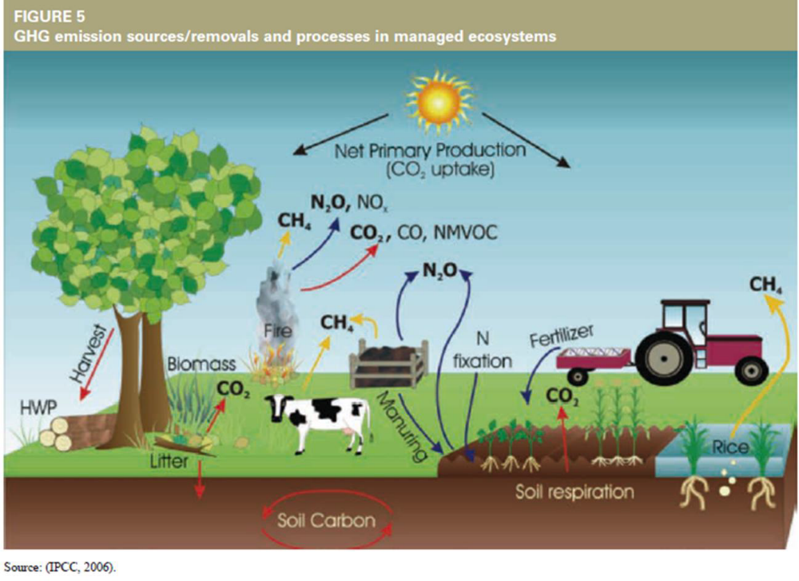

Slide 45
IMPACTS OF CLIMATE CHANGE
Oceans
Studies suggest that global warming will cause sea levels to rise by 20 – 140 cm by the year 2100, most of that due to thermal expansion of the ocean water as it warms up.
The result would be inundated wetlands and lowlands, eroding shorelines, and increased coastal flooding.

Slide 46
IMPACTS OF CLIMATE CHANGE
Rainfall
Global rainfall is expected to increase as much as 12%, but most of this will likely fall in areas that are already wet.
Forests will benefit from rainfall increase, but improved weed growth may reduce crop-yields.
Leaching of nutrients will increase.
Dry areas could expect decrease in rainfall of up to 10% while evaporation rates could increase because of the higher temperatures – resulting in drier soils and lower crop yields.

Slide 47
IMPACTS OF CLIMATE CHANGE – Agric Sector
Changes in precipitation and temperature will reduce average yields and increase variability in production
In the tropics, crop yields are projected to decrease mainly due to dependence on rain-fed agriculture.
Complete losses of agricultural produce (crop pests; livestock and crop diseases - leading to increased rural poverty and forced migrations.
Exacerbated challenges due to limited access to technologies to adapt (lack of early warning systems) & of weaknesses in the extension, insurance and credit systems

Slide 48
CLIMATE CHANGE IMPACTS ON THE AGRIC SECTOR…(Cont’d)
Changing climatic patterns may also interfere with germination or with other key stages in the life cycle of plants.
Certain species or the entire ecosystems may be lost.
As temperature increases, higher crop yields are expected in the temperate regions.

Slide 49
CLIMATE CHANGE IMPACTS ON THE AGRIC SECTOR…(Cont’d)
Where rainfall declines, more severe yield impacts are expected.
Agro-ecological shifts and increased temperatures may lead to more heat stress related deaths in livestock.
Most studies indicate that food prices could rise globally.
Economists estimate that these effects could reduce the incomes of small holder farmers and poor urban consumers.
This could result in higher numbers of people world-wide being at risk of hunger (IPCC, 2001d).

Slide 50
IMPACTS OF CLIMATE CHANGE IN ZAMBIA
Rising Temperatures – Zambia has experienced increasing average temperatures over recent decades, with more frequent heat waves.
Impacts:
Heat stress on crops and livestock
Increased evapotranspiration (faster soil moisture loss)
Reduced labour productivity in agriculture
Increased demand for water and electricity

Slide 51
IMPACTS OF CLIMATE CHANGE IN ZAMBIA
2. Increased drought frequency – droughts are becoming more frequent and severe, particularly in Agroecological Region 1 (parts of Southern and Western Zambia)
Impacts:
Crop failure (especially maize)
Livestock deaths
Reduced hydropower generation (increased load management)
Food insecurity
Increased poverty in rural households

Slide 52
IMPACTS OF CLIMATE CHANGE IN ZAMBIA
3. Flooding and Extreme Rainfall – Some parts of Zambia, especially northern and north-western regions (Agroecological Region III), are experiencing intense rainfall events and flooding.
Impacts:
Destruction of infrastructure (roads, bridges, schools)
Displacement of communities (environmental refugees)
Water borne diseases (Cholera, dysentery, bilharzia)
Crop damage
Flash floods have become common in cities like Lusaka!

Slide 53
IMPACTS OF CLIMATE CHANGE IN ZAMBIA
4. Impacts on Agriculture – In Zambia, agriculture is highly vulnerable to CC because it is largely rainfed.
Impacts:
Shortened growing seasons
Delayed onsets of rains (and early withdrawal)
Increased pests and diseases (e.g FAW, Tuta absoluta, etc)
Declining soil fertility due to erosion and leaching
The above directly threaten smallholder farmers’ livelihoods!

Slide 54
IMPACTS OF CLIMATE CHANGE IN ZAMBIA
5. Hydropower and Energy Crisis – Zambia relies heavily on hydroelectricity. Reduced rainfall lowers reservoir levels at major dams such as the Kariba Dam, Kafue Gorge Upper & Lower Dams, Itezhi-tezhi Dams, etc).
Impacts:
Country-wide load management (loadshedding)
Increased diesel generator use (more GHG emissions)
Economic slowdown
Increased production costs for industries

Slide 55
IMPACTS OF CLIMATE CHANGE IN ZAMBIA
6. Water Resources Stress – Climate change affects river flow patterns and ground water recharge.
Impacts:
Reduced access to safe drinking water
Conflicts over water resources
Reduced irrigation potential

Slide 56
IMPACTS OF CLIMATE CHANGE IN ZAMBIA
7. Biodiversity Loss – Changing temperature and rainfall patterns affect ecosystems and wildlife.
Impacts:
Habitat loss
Wildlife migration
Increased human-wildlife conflict
Forest degradation

Slide 57
IMPACTS OF CLIMATE CHANGE IN ZAMBIA
8. Public health impacts – climate change increases:
Malaria transmission zones
Cholera outbreaks during floods
Malnutrition due to crop failure
Heat related illnesses
Rural and peri-urban communities are particularly vulnerable.

Slide 58
IMPACTS OF CLIMATE CHANGE IN ZAMBIA
9. Economic impacts – climate-related shocks affect:
GDP growth
Mining operations (due to electric power shortages)
Agricultural exports
Household income stability
Persistent climate shocks undermine long-term economic development.

Slide 59
IMPACTS OF CLIMATE CHANGE IN ZAMBIA
10. Social impacts:
Rural-urban migration (creation of shanty settlements, urban pollution)
Increased poverty
Gender inequality (women often bear greater burden for water and food provision)
Resource-based conflicts and rising crime incidences

Slide 60
IMPACTS OF CLIMATE CHANGE IN ZAMBIA
Because Zambia’s economy depends heavily on natural resources, climate change poses systematic risks across sectors.
Therefore, CC in Zambia is not just an environmental issue – it is also a food security, energy, water and developmental issue.

Slide 61
CLIMATE CHANGE IMPACTS ON OTHER SECTORS
impacts of CC vary depending on the sector and the location
impacts of CC on different sectors of society are interrelated.
  Drought can harm food production and human health.
  Flooding can lead to disease spread and damages to ecosystems and infrastructure.
  Human health issues can increase mortality, impact food availability, and limit worker productivity.

Slide 62
CLIMATE CHANGE IMPACTS ON OTHER SECTORS
More frequent intense heat waves could increase illnesses and deaths from heat stress (made worse in urban areas with lower air quality)
Increased risks of injury and death arising from increased frequency and intensity of floods and droughts
Loss of shelter leading to population displacement (environmental refugees)
Hunger and malnutrition due to crop failures (droughts, floods, insect outbreaks)
Higher risks of infectious disease epidemics
Increased waterborne infectious diseases (Urban cholera outbreaks likely to increase)
Expansion of malaria transmission to higher altitudes and possibly higher latitudes

Slide 63
CONCEPTS OF ADAPTATION & MITIGATION
1. Adaptation
Adaptation is defined as activities that aim “to reduce the vulnerability of human or natural systems to the impacts of climate change and climate-related risks, by maintaining or increasing adaptive capacity and systems resilience” (OECD-DAC, 2011).
Adjustment in natural or human systems in response to actual or expected climatic stimuli or their effects, which moderates harm or exploits beneficial opportunities.
Notes:
OECD – Organisation of Economic Corporation and Development; DAC – Development Assistance Committee

Slide 64
CONCEPTS OF ADAPTATION & MITIGATION… (Cont’d)
Adaptation measures deal with the impacts of climate change and have the objective of reducing the vulnerability of human and natural systems
Mitigation addresses the causes of the problem, which involves reducing greenhouse gas concentrations in the atmosphere

Slide 65
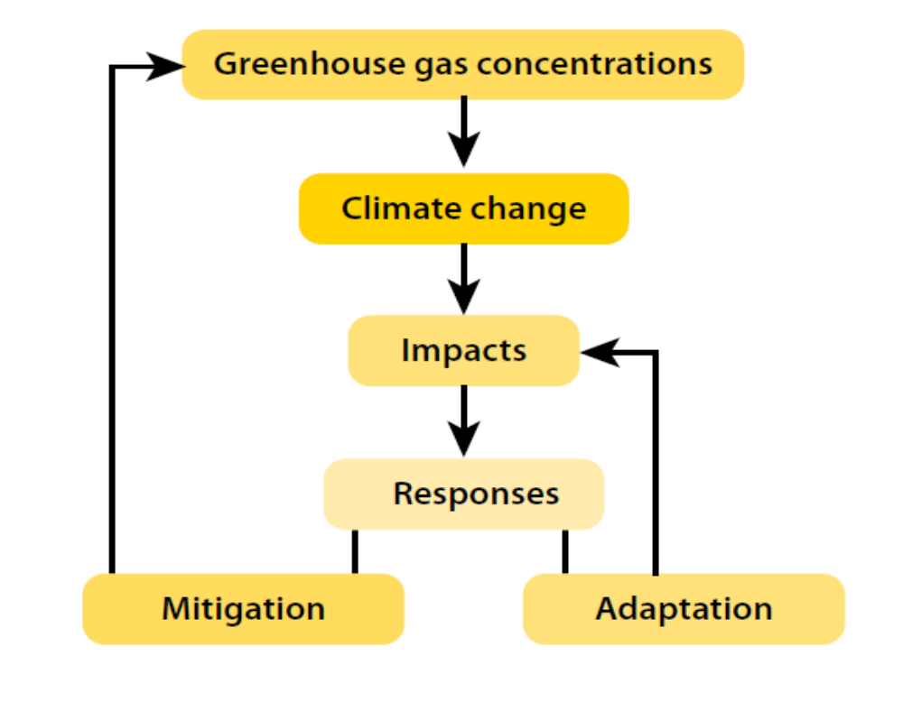

Slide 66
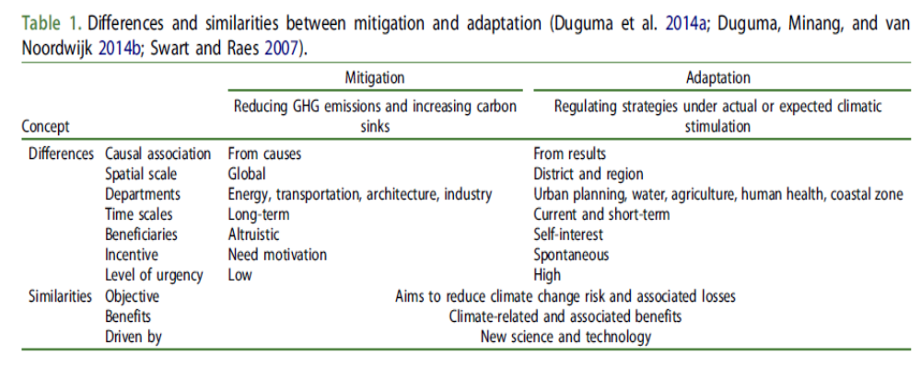
DIFFERENCES AND SIMILARITIES BETWEEN M&A

Slide 67
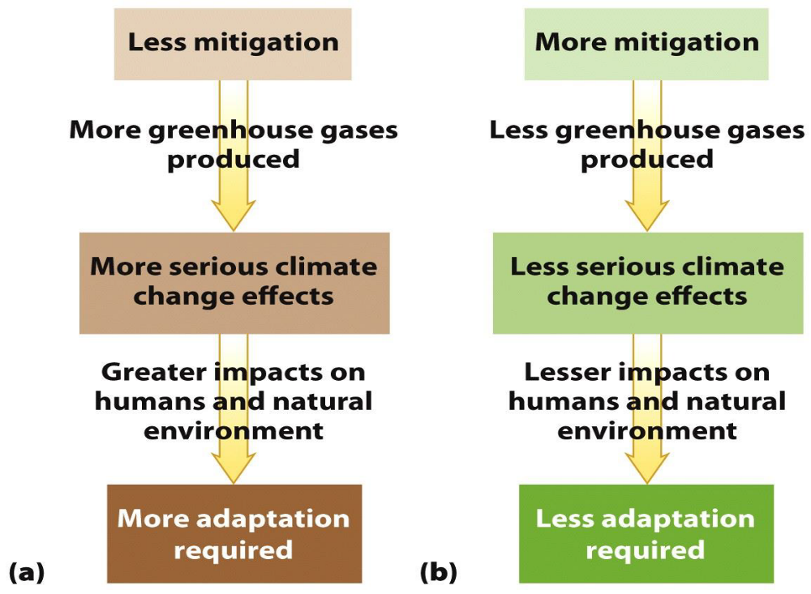

Slide 68
In areas under frequent threats of climate-related emergencies, disaster risk reduction (DRR) and disaster risk management (DRM) are key entry points for climate change adaptation.
For example:
  availability and accessibility of good quality seeds is paramount in enhancing the resilience of food production systems in order to minimise dependence on direct external assistance.
  Early warning systems such as Community Flood Information Systems help to prepare potential victims
In Zambia, DRR and DRM are enforced by the DMMU

Slide 69
Other Examples of DRR and DRM Measures in Climate Change Adaptation
Relocation of communities due to sea/river level rise
Promotion of water harvesting techniques by building large scale irrigation systems and other on-farm water harvesting technologies
plant breeding in response to shifting agro-ecological zones and new stresses; e.g. breeding for drought and floods tolerance
Promotion of diversified livelihoods and integrated farming systems
Construction and promotion of drainage systems

Slide 70
Sendai Framework [2015-2030]
Adopted in 2015, in Sendai, Japan, by UN member states
Focusses on global disaster risk reduction (DRR) – adaptation and resilience building
Addresses all types of disasters: climate-related (floods, droughts, storms) and non-climate disasters (earthquakes, tsunamis, etc.)
Goal: reduce disaster risk and losses in lives, livelihoods and assets
Encourages disaster preparedness, early warning systems, and risk informed planning
Does not deal with emission reductions
Voluntary, non-binding framework

Slide 71
Sendai Framework [2015-2030]
Has 7 global targets, including:
    Reduce disaster mortality
    Reduce number of affected people
    Reduce economic losses
    Increase early warning coverage

Slide 72
Sendai Framework [2015-2030]
Zambia is party to the Sendai Framework for DRR, 2015-2030
Zambia’s national disaster risk management policies and frameworks are aligned with the Sendai Framework
Zambia has domesticated the Sendai Framework through its Zambia National Disaster Risk Management Framework (2017-2030)
In Zambia, activities in line with the Sendai Framework include:
    Flood preparedness in the Kafue Basin
    Drought early warning systems
    Community-based disaster risk reduction

Slide 73
ADAPTATION STRATEGIES IN AGRICULTURE
Adaptation strategies in agriculture are based on a combination of:
specific actions (e.g. switching from one crop variety to another - drought tolerant; early-maturing; FAW tolerant variety);
systemic changes -
Change farming practices to conserve soil moisture, organic matter and nutrients (minimum tillage, pot holing, etc).
Build response capacity (improvement of weather monitoring systems; conserve genetic resources)
Reduce soil erosion and land degradation (improved soil management by mulching, minimum tillage, construction of contour ridges).

Slide 74
Adaptation Strategies in Agriculture….(Cont’d)
iv. Improve water use efficiency and availability (water harvesting – potholing, construction of reservoir/dams).
v. Change land topography to improve water uptake and reduce wind erosion (e.g. growing cover crops, agroforestry crops, planting trees).
vi. Adopt livestock rotational grazing practices to improve soil cover, increase water infiltration/retention and promote natural soil forming processes.

Slide 75
ENABLING ENVIRONMENT FOR ADAPTATION
Policies to guide adaptation to CC (National Adaptation Plan - NAP, 2023; National Policy on Climate Change - NPCC, 2016; National Adaptation Program of Action (NAPA, 2010)
Climate proofing of infrastructure (more windows, solar energy, water harvesting points, etc)
Re-allocation of water (between and within sectors)
Strengthening land/water right access
Crop insurances
Improved weather forecasting capacity
Improved hydrological monitoring – for floods/droughts
Review of food storage (R&D in Food & Post-harvest handling technologies)

Slide 76
ADAPTATION AT INDIVIDUAL FARMER LEVEL
Plant different varieties or species of crops (crop diversification…e.g. maize with sorghum, cowpeas, groundnuts, etc.), or rear different breeds or species of livestock (fish - aquaculture). Diversification spreads the risk.
Grow drought-tolerant and early-maturing crop varieties
Alter agronomic practices (crop rotation, mulching, crop residue retention, minimum/zero tillage, potholing, cover cropping, etc.)
Enterprise diversification (having multiple agro enterprises – animal, crop, fish farming, bee keeping, vegetable gardening, food processing, etc.).

Slide 77
ADAPTATION AT INDIVIDUAL FARMER LEVEL…
Rain water harvesting (constructing contour ridges, building small farm ponds, digging infiltration pits or potholing)
Agroforestry (planting fertiliser trees such as Cajanus cajan, Gliricidia sepium, Fardherbia albida, Sesbania sesban, Tephrosia vogellii, etc)
Adjust planting time (Staggered planting, i.e. plant crops in phases to reduce risk of total crop failure; use seasonal weather forecasts to determine optimal planting time)

Slide 78
ADAPTATION AT INDIVIDUAL FARMER LEVEL…
Water management and irrigation (treadle pumps, drip irrigation, solar powered pumps) to reduce dependence on rainfall; mulching (to reduce evaporation and maintain soil moisture)
Financial and institutional strategies (joint farmer cooperatives, social capital groups - leading to improved access to climate information, credit, inputs, markets)

Slide 79
ADAPTATION AT INDIVIDUAL FARMER LEVEL…
In summary, an individual farmer should aim to:
    Reduce exposure to climate change (drought tolerant crops and varieties, irrigation, etc)
    Increase resilience (diversification, soil health, etc)
    Spread the risk (mixed farming, etc); and
    Use climate information.

Slide 80
ECOSYSTEM-BASED ADAPTATION (EBA)
EBA is a nature-based solution that uses ecosystem services to reduce vulnerability and help people adapt to the impacts of climate change.
Ecosystem services are the benefits humans obtain from the ecosystems.
They are the natural processes and functions provided by the environment that support human life, economic activities and overall wellbeing.

Slide 81
ECOSYSTEM-BASED ADAPTATION (EBA)…
Ecosystem services are grouped into four categories:
  Provisioning services – tangible products obtained from ecosystems such as food (fruits, fish, honey, fresh water, timber, fuelwood, medicinal plants, genetic resources)
  Regulatory services – benefits obtained from the regulation of ecosystem processes (carbon sequestration by forests, flood control by wetlands and forests, water purification by forests, soil erosion control, pollination of crops)

Slide 82
ECOSYSTEM-BASED ADAPTATION (EBA)…
  3. Supporting services – underlying ecological processes that make other services possible; services that are not directly consumed but are essential for food production and ecosystem stability (e.g. nutrient cycling, soil formation, photosynthesis, biodiversity maintenance).
  4. Cultural services – recreation and tourism, spiritual values, educational and research opportunities, aesthetic enjoyment…e.g. national parks provide revenue and cultural identity)

Slide 83
ECOSYSTEM-BASED ADAPTATION (EBA)…
Why Ecosystem Services Matter:
They support food security
Reduce vulnerability to CC
Sustain livelihoods (especially for smallholder farmers)
Maintain biodiversity and resilience.

Slide 84
COMMUNITY-BASED ADAPTATION (CBA)
CBA is a locally-driven approach to climate change adaptation that empowers communities to be able to:
    Identify climate risks
    Use indigenous knowledge
    Design locally-appropriate solutions
    Strengthen collective resilience
Thus, CBA emphasizes the importance of engaging local communities, especially vulnerable groups and people, in the adaptation process.

Slide 85
COMMUNITY-BASED ADAPTATION (CBA)….
In Zambia, CBA is particularly important in Regions I and II, which are highly drought-prone as most rural households in these regions depend on rainfed agriculture.

Slide 86
COMMUNITY-BASED ADAPTATION (CBA)….
Why is CBA particularly important in Zambia?
High climate vulnerability – the country experiences increased drought occurrences, flash floods, shortened rainy seasons, and heat stress
Heavy dependency on natural resources – most rural communities rely on rain-fed agriculture, forest products, fisheries, wetlands, etc.

Slide 87
COMMUNITY-BASED ADAPTATION (CBA)….
Key features of CBA in Zambia:
  Integration of indigenous knowledge – communities use local rainfall indicators (such as wind patterns, flowering of trees, bird behaviour), traditional seed varieties and landraces, as well as indigenous soil and water conservation practices. Blending scientific forecasts with local knowledge improves adaptation.
  Participatory planning structures – In Zambia, CBA often works through Ward Development Committees (WDCs), District Climate Change Committees (DCCCs), and Community Development Committees (CDCs). These ensure ownership and accountability.

Slide 88
COMMUNITY-BASED ADAPTATION (CBA)….
Key features of CBA in Zambia:
  Ecosystem-based approaches – most CBA initiatives integrate ecosystem restoration such as agroforestry, afforestation, reforestation, CA, wetland protection.

Slide 89
COMMUNITY-BASED ADAPTATION (CBA)….
Examples of CBA interventions in Zambia:
  Agroecology– promoted by NGOs and the government (Ministry of Agriculture, Ministry of Green Economy and Environment) to promote soil moisture retention, resilience, linkage to markets, and gender inclusion.
  Famer field schools (FFS) – enables farmers to experiment with climate resilient practices.
  Community seed banks – help to conserve drought, pest and disease-tolerant local crop varieties and enhance seed security

Slide 90
COMMUNITY-BASED ADAPTATION (CBA)….
Examples of CBA interventions in Zambia:
  Water harvesting projects– check dams (e.g. in Magoye), small irrigation schemes
  Alternative livelihoods – bee keeping, village savings and loan groups (e.g. village banking schemes), agro-processing

Slide 91
COMMUNITY-BASED ADAPTATION (CBA)….
Strengths of CBA in Zambia:
  Builds local ownership
  Incorporates local knowledge
  Enhances social cohesion
  Improves gender inclusion (when well-designed)
  Its cost-effective, compared to top-down approaches

Slide 92
COMMUNITY-BASED ADAPTATION (CBA)….
Key challenges associated with CBA in Zambia:
  Limited funding at district level
  Weak technical capacity in some districts
  Climate information is not always localised
  Dependency on donor-funded projects
  Limited monitoring and evaluation systems.

Slide 93
COMMUNITY-BASED ADAPTATION (CBA)….
Gender and Social Inclusion in CBA – in Zambia:
  Women, youth, the elderly, and differently-abled persons are often vulnerable to climate impacts but have limited access to land, credit and extension services
  Effective CBA must intentionally integrate gender-responsive and inclusive approaches

Slide 94
COMMUNITY-BASED ADAPTATION (CBA)….
Policy and Institutional Context – the case of Zambia:
CBA aligns with Zambia’s:
    Ministry of Green Economy and Environment climate coordination role
    National Climate Change Policy
    Nationally-determined contributions (NDCs)
Decentralization policies have enabled district-level adaptation planning.

Slide 95
LIVELIHOOD DIVERSIFICATION (LD)
LD is most applicable at community and household level.
Its goal is to create an environment that enables people to shift to additional sources of incomes while maintaining a certain level of living quality.
inclusion of women, youths, the differently-abled and inclusiveness of NAPs can assist economic growth and increase the income of vulnerable people.
LD is usually linked to CBA programs and strategies

Slide 96
FACTORS THAT HELP BUILD RESILIENCE
◻Colding and Berkes (2003)
learning to live with change and uncertainty, such as learning from crises and developing coping strategies
nurturing diversity in its various forms, such as nurturing a diversity of institutions to respond to change and creating political space for experimentation
combining different types of knowledge for learning, such as building capacity to monitor the environment and building capacity for participatory management

Slide 97
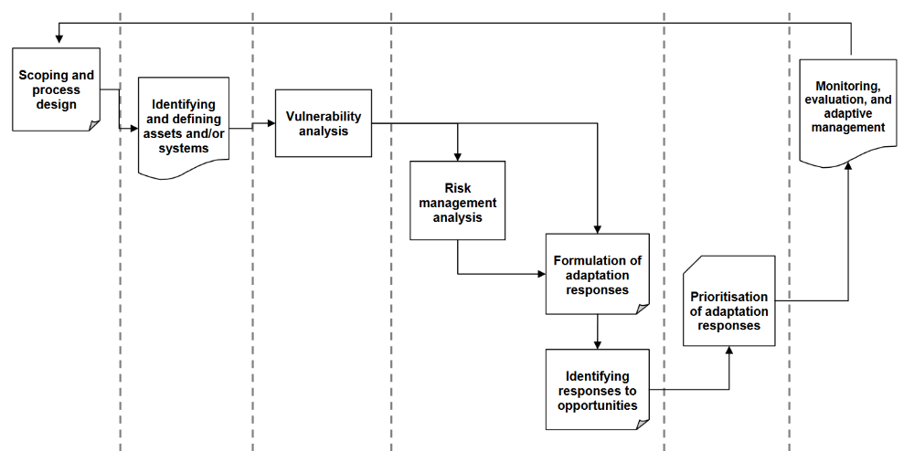
Strategic steps to adaptation

